Slide 1

Solar Cookers Project
Burkina Faso
Olivet & Sarrebrücken Lions club .
17th september 2018.

Slide 2
Solar Cookers Project
Burkina Faso
« The earth receives from the sun in one hour more energy that humanity needs for one year »

Slide 3
Genesis of the project.
Idea of a common action to be developed by our two clubs to strengthen relationship
Each club carries out separetely proposal(s)
End of 2017, Reims meeting for proposals debriefing
Selection of « Solar Cookers Project » which will be submitted to clubs approval
Agreement of the two clubs for this project , each club providing funds at the heigth of 10000€
Dossier sent to Oak Brook in the prospect of Lions centenary.... Without success

Slide 4
Launching of the project.
General Context.
More than 2 billions people in the world cook every day their meal on wood fire
Collecting wood deteriorates women social life, who spend a great part of their time on that task to the detriment of their other activities
In west Africa, and more specificaly close to Sahel, millions of people are facing wood rarefaction, while cooking food is a vital need
Consequences of this rarefaction : price increase of wood and great difficulty of supplying

Slide 5
Launching of the project.
General Context.
90% of wood used in Burkina Faso is for cooking, and wood consumption is far above forest renewal capacity
Feeding safety severely affected

Slide 6
Launching of the project.
The solution : the solar cooker.

Slide 7
Launching of the project.
The solution : the solar cooker.
The accuracy of parabolic shape creates a foyer comparable to wood fire and delivers a temperature of 1000°C
The surface of the parabol has been designed to obtain a power of
1200 W
A simple tunning system allows following the apparent course of the sun , simply and easily
A design of « open pararabol » making of this device a friendly user space

Slide 8
Launching of the project.
The solution : the solar cooker.
An economic device.
Significant costs saving on wood purchases
Population less vunerable when facing wood price increase
An « ecologic » device.
An essential gear for ecosystems rehabilitation
A tool to figth deforestation and desertification
A device free of smokes and carbon dioxyd

Slide 9
Launching of the project.
The solution : the solar cooker.
A device safe and robust.
Current assembling of materials and pieces of equipment , reliable and robust
Simple design and engineering
Simple tunning for power control
Safer to handle compared to devices using fossile energies
No flamme, instantaneous ignition
Parabol remain cold

Slide 10
Launching of the project.
The solution : the solar cooker.
A device having no damagable effect on health
No nocive smoke affecting lumbs and sigth
Stand up position for people preparing meals
Water pasteurization

Slide 11
Launching of the project.
Test stage N°1 – January 2018.
Choice of Burkina Faso
Because a similar operation has been carried out by the designer of the cooker, in this country , with a good return of experience
Because a friend of Tours lions Club was acting in this country since eigth years, and more specificaly in Bereba, offering his excellent knowledge of the sites to be visited, of people and usages
Choice for a quick start
« Forget » Oak Brook response( otherwise we loose one year)
In january 2018 to take opportunity of Lions Tours visit in Béréba ( significant time saving)

Slide 12
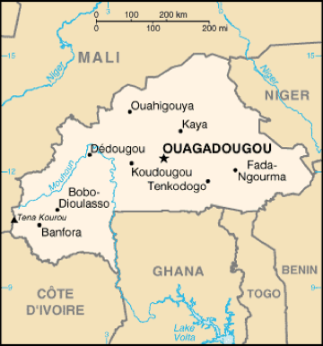
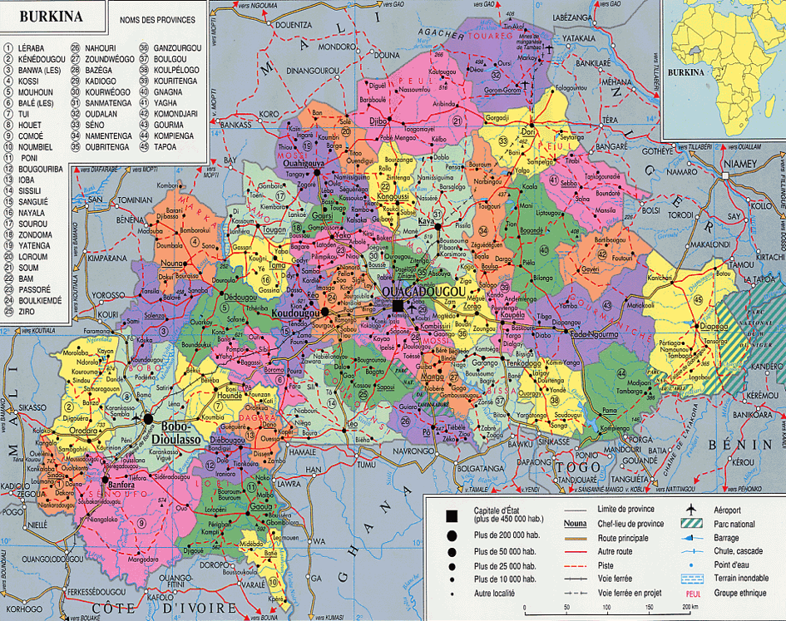
Launching of the project.
Test stage N°1 – January 2018.
Localisation.

Slide 13
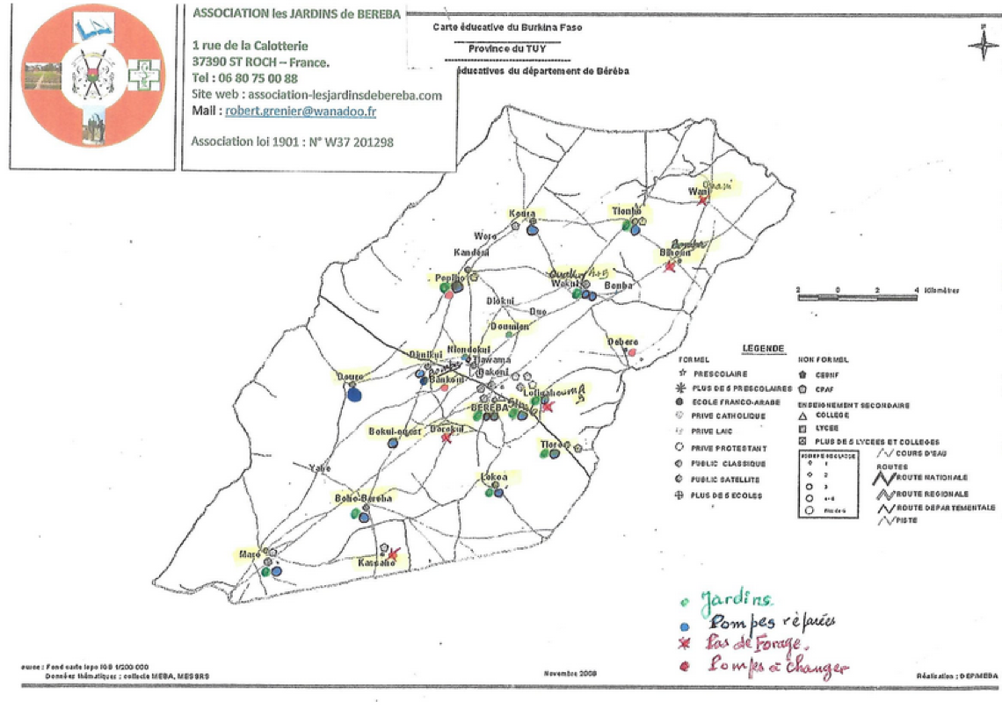
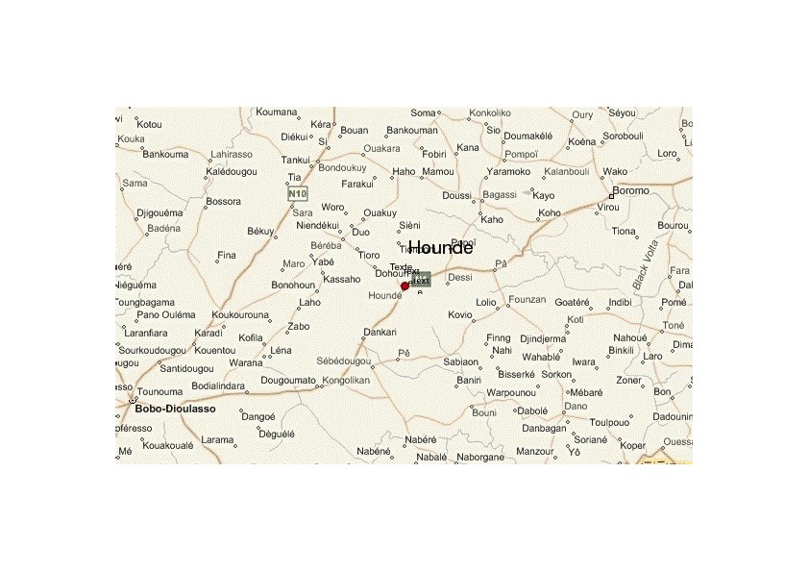
Launching of the project.
Test stage N°1 – January 2018.
Localisation.

Slide 14
Launching of the project.
Test stage N°1 – January 2018 .
15 cookers implemented in families of Béréba village
Training session in Ouagadougou for 6 persons
Test stage N°1 – April/may 2018.
First feed back; some key issues :
  Device friendly user or not?
  Cooking as well as traditional wood fire?
  showing savings in wood purchases?
First interim conclusion: implementation of cookers can be continued
Choice of families for further implementations: to avoid any kind of favoritisme, we asked to chiefs of VCD( Villages Councils for Development) to establish list of families where will be implemented cookers (and extended to the whole departement)

Slide 15
Launching of the project.

Slide 16
Launching of the project.
Test stage N°1 – April/may 2018.
Tracing of mail exchanges with Ivette Koura.
Koura I 2018 05 27
Ma premiere sortie c'etait le 14 mai 2018 dans la zone de Maro. La formation a eu lieu a Boho-Bereba.
Etaient present: le CVD de Maro et son epouse;
-Kamboua Nikiengna et son epouse;
-Le CVD de kassaho;
Le
-Le CVD de Boho-Bereba et ses deux epouses;
-L'epouse du conseiller de Boho-Bereba;
Et a cette formation nous d'abord chauffe de l'eau jusqu'a ce qu'elle bout ce qui nous pris trente minutes ensuite nous avons prepare du riz gras en une heure trente cinq minutes environ .un plat qu'ils ont bien deguste. A la fin de la journee ils m' ont dit de ne plus revenir que la formtion a ete bien comprise.
Le 16 et 17 mai 2017 a eu lieu la formation experimentation sur les cuiseurs solaire .
Etaient present : -le CVD de popioho et son epouse;
-L'epouse du conseiller de popioho;
-La conseillere de popioho;
-L'epouse du CVD de keindeni;
Absents: Bazi Nikienta et son epouse etaient en deplacement pour des funerails dans un autre village.
1er jour : ensemble nous avons préparé du riz elles ont appris a manipuler l'appareil.
2eme jour: j'ai ete chez chacun d'eux pour voir comment elles s'excercent. Ceux de Koura etaient toujours absents. Chez sieni Emile l'appareil est mal placé (trop proche du mûr) . Chez le CVD de keindeni c'etait la cuisson des oeufs. Chez la conseillere de popioho, elle preparait du haricot. Le CVD de popioho dit qu'il lui faut des lunettes c'est là je les ai dit de chercher des lunettes noirs de 500f qui est sur nos marchés
Je compte repasser dans tous les villages pour une supervison.

Slide 17
Launching of the project.
Test stage N°1 – April/may 2018.
Tracing of mail exchanges with Ivette Koura.
Le 20 mai 2018 etait la formation expérimentation sur les cuiseurs solaire.
Etaient present ce jour :-koura Rosalie;
-l'epouse de Bagagna Amada;
-Koura Gninimawede;
-Koura Hayazouma;
-L'epouse de Koura Zounwe;
-0uedraogo Awa;
-L'epouse de Kouda Ousmane;
-la fille de Bihoun Bounsi;
-L'epouse de Guiguemde Soulemane;
-Doye Hadamouko.
Absents: Koura Mamadou qui m'a dit qu'il sait utiliser le cuiseur et qu'il prepare la déçu déjà.
Zoumbara wohi en deplacement.
Nous cuis le riz ce jour.
Le lendemain nous avons préparé du haricot. Troisieme jour j'ai tourné. Chez certaines :Koura Hayazouma, koura Gninimawede,Kouda Ousmane ou la femme preparait le haricot.je compte continuer mes tournées les jours bien ensoleillés.
2018 05 28
Je n'ai pas pu donné de formation dans la zone de Ouakuy pour raison: le CVD et le Conseiller m'ont appelé pour me dire que lamoussa n'a pas fini de placer les cuiseu

Slide 18
Launching of the project.
Test stage N°1 – April/may 2018.
Tracing of mail exchanges with Ivette Koura.
Liste de presence:
-Toboua Zonas, CVD Ouakuy et son epouse;
-Bihoun Yewan,Conseiller Ouakuy;
-Fofana Sidiki, CVD Tiombio,
-Zoumbahan Loya ,Conseillere Tiombio;
Sieni Lonkou ;
Bihoun lamoussa Bambou.
Ils ont choisi la cuisson des pates et de la viande.commencer a 14 heures 45minutes avec une journee moins ensoleillee nous avons fini la cuisson a 16heures :40minutes.
le 03 juin 2018 a eu lieu la formation et experimentation de cuiseur solaire a Ouakuy.
Etaient present a cette seance :_ Toboua zonas CVD de Ouakuy et son epouse;
-Bihoun Yewan ,conseiller de Ouakuy;
-Bihoun lomoussa Bambou, de ouakuy;
-Zoumbahan Loya, conseillere de Tiombio;
-Fofana Sidiki,CVD de Tiombio ;
-Sieni Lonkou, de Tiombio.
Les participants ont choisi la cuisson de sppagutis et du mouton.
Avec une journée moins ensoleillée et avec l'attente
des retardateurs nous avons commencé à 14heures 45 minutes et fini la cuisson dans les environs de 16heures 40 minutes. Avec la saison pluvieuse nous avons arrêté de continuer la formation le Dimanche prochain apres la messe de l'église.
23 juillet 2018.
Bonsoir Patrice,
Depuis que la saison pluvieuse s'est installée beaucoup des familles ont déménagé en brousse et actuellement nous sommes dans une période de pluies intances.
Les familles qui resident au village utilisent les cuiseurs les jours ensoleillés.baucoup de gents sont dans le besoin. J'ai aussi discuté avec les C.V.D des villages de Boho-Bereba, Ouakuy, Popioho, Koura, keindeni, Lofikahoun et celui de Bereba sur les besoins de cuiseurs de la population mais ils m'ont dit que beaucoup de gens sont dans le besoin ils ont même promis de m'envoyer des listes d'ici ce vendredi 27/07/2018.
Passez de bonnes vacances. A bientôt.

Slide 19
Solar cooker project. Continued’
Test stage N° 2. January 2019.
This second stage should allow the implementation of another 50 cookers, thanks to Saarbrücken Lions club
Forecasted costs:
  Cookers............................................... 7900,00 €
  Training................................................ 1100,00 €
  Settlement and follow up........................480,00 €
  TOTAL...........9480,00 €

Slide 20
Solar cooker project. Continued’

Slide 21
Solar cooker project. Continued’
Test stage N° 2. January 2019.
The target of the second stage:
To consolidate the test on the basis of 100 cookers
To provide a set of pertinent information on all aspects of « solar cooking »
  Women adaptation to the cooker
  Efficiency of the cooker
  Strengh / weakness of the proposed solution
  Potential improvements
  Usage frequency
  Savings in wood (or charcoal) purchases

Slide 22
Solar cooker project. Continued’
Test stage N° 2. January 2019.
Two missions must be schedulded
  Mission N°1 (begining 2019 ?) to start the second stage of the project
  Mission N°2 (date to be fixed) to collect complete information........for further extension of the project.
  AND THEN WHAT NEXT ?

Slide 23
Solar cooker project. Continued’
The will of the french project group is to extend the system to Béréba departement population (approximately 5000 families)
Realizing such an operation needs to raise funds( 500000€). It is then necessary to create a specific structure- independant of the club but with a partnership contract- able to collect funds, these funds offering tax advantages to donator companies( in France one can deducts 66% of total funds on tax amount-under defined limits)
« Energie Béréba » association - association type Loi 1901- as been created in that purpose: it integrates members of Olivet Lions Club and , we hope for the futur, members of Saarbrücken Lions Club
Year 2019 is then of crucial importance : validation of datas and information on the model(and improvements) to build a consistent project for years 2020/2022, project which will be presented to potential donators.

Slide 24
Solar cooker project. Continued’
Basic principles as guide lines for the project:
To obtain from the cooker supplier a raisonable price
50% of cooker cost financed by « Energie Béréba » association(year one)
50% (year two) financed by families on basis of savings on wood purchases realised during year one
Agreement from the supplier to realise (at a pace and under conditions to be defined) a part of cookers manufacturing in Burkina Faso
On the basis of demographic datas at disposal to day, that means at minimum 5000 cookers to be installed

Slide 25
Solar cooker project. Continued’
In that perspective, we must keep in mind (an insist on) following statement :
« Manufacturing and sale of solar cookers must not be seen as a pur activity of commercial developement being part of economical growth or globalization of trade, but rather as a factor to maintain a vital social and ecological ground. »

Slide 26
Sustainable development.
FAO information gives a wood consumption of 1,25 kg/per day/ per person.
For an average family( 6 persons), that makes 2737,5 kg of wood/ per family/per year.
Wood contains:
  80% of organnic subtances, of which
    50% of carbon
    43% of oxygen
    5% of hydrogen
    2% of nitrogen

Slide 27
Sustainable development.
Wood contains:
  20% of others
    Water18%
    Mineral substances2%
400 g of carbon per Kilo of wood gives1,47 kg of carbon dioxyd per kilo of burned wood and therafter 4024,125 kg of carbon dioxyd per family and per year.
2 billions of people cooking on wood fire(330 millions de familles) reject 1,328 billions ton of carbon dioxyd.
Carbon dioxyd emission for european countries is 4,5 billions ton per year.

